Slide 1
TA 111: Technical Arts
2023-24 II
Lecture 22
Intersection of Solids - II
Dr. Syam Nair
Department of Civil Engineering
IIT Kanpur
Office: FB 307
Phone: 6424
Email: syamnair@iitk.ac.in

Slide 2
Mandatory Reading
Thomas E. French, “Engineering Drawing and Graphics Technology”
Chapter 10 – Surface Intersections

Slide 3
Intersection of Two Solids
Two Methods:
  Selected line method
    Select sufficient number of lines on a surface and find the points where each of these lines intersects the other surface. A line joining these points would give the line of intersection between two surfaces.
  Cutting plane method

Slide 4
Two Prisms: Selected Line Method
c
c, c’
b
4
8
p’
d
s’
p
a
5
d, d’
b, b’
s
1
r’
q, s
q’, s’
1,3
5, 7
p
r
6
q’
2
7
r
b’
r’
q
3
2
6
d’
a, a’
a’
d
a,c
b
1
5
s
s’
Select sufficient number of lines on a surface and find the points where each of these lines intersects the other surface. A line joining these points would give the line of intersection between two surfaces.
p, r
2
6
4
8
p’, r’
q
7
q’
3
d’
a’,c’
b’

Slide 5
Two Prisms: Alternate Method
1
1
1
5
4
EV
EV
4
5
6
2
2
EV
EV
6
3
3
3

Slide 6
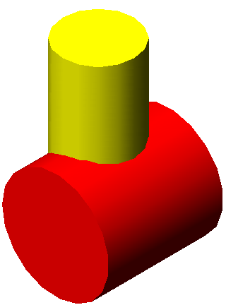
Two Cylinders: Selected Line Method
3_{H}
4_{H}
2_{H}
5_{H}
6_{H}
1_{H}
7_{H}
12_{H}
8_{H}
11_{H}
10_{H}
9_{H}
H
F
P
12_{F}
11_{F}
9_{F}
7_{F}
8_{P,}12_{P}
7_{P,}1_{P}
1_{F}
10_{P}
2_{F}
10_{F}
6_{F}
9_{P},11_{P}
6_{P,}2_{P}
3_{F}
5_{F}
5_{P,}3_{P}
4_{F}
4_{P}

Slide 7
Intersection of Two Solids
Two Methods:
  Selected line method
  Cutting plane method
    Pass a number of cutting planes through each of the given surfaces simultaneously. Each plane will cut a line (straight or curved) from each given surface. These lines will intersect in a point (or points) common to both surfaces. A line connecting those points will give the line of intersection of the given surfaces.

Slide 8
Two Cylinders: Cutting Plane Method
6
Pass a number of cutting planes through each of the given surfaces simultaneously. Each plane will cut a line (straight or curved) from each given surface. These lines will intersect in a point (or points) common to both surfaces. A line connecting those points will give the line of intersection of the given surfaces.
5
4
3
2
1
1
2
3
4
5
6

Slide 9
Cylinder and Prism: Selected Line Method

Slide 10
Cylinder and Prism: Cutting Plane Method

Slide 11



Cone and Cylinder Intersection

Slide 12
Cone and Cylinder: Selected Line Method
2
1
12
3
j
j
11
i
k
k
i
l
l
4
a
a
10
g
O
g
b
b
5
e
c
c
e
9
d
d
6
8
7
O
O
b, l
a
a
c, k
c
b
l
k
d, j
d
j
e, i
e
i
g
g
4
10
7
1
3, 5
2, 6
1, 7
8, 12
9, 11
6, 8
5, 9
4, 10
3, 11
2, 12

Slide 13
Cone and Cylinder: Cutting Plane Method
d
e
c
b
a
1
b
2
c
3
d
e
4
5
6
7
8
9
e
e
d
d
c
c
b
b
1
a
2
4
3
5
6
7
8
9

Slide 14
Cone and Cylinder: Cutting Plane Method
2
1
12
3
j
j
11
i
k
k
i
l
l
4
a
a
10
g
g
b
b
5
e
c
c
e
9
d
d
6
8
7
b, l
a
a
c, k
c
b
l
k
d, j
d
j
e, i
e
i
g
g
4
10
7
1
3, 5
2, 6
1, 7
8, 12
9, 11
6, 8
5, 9
4, 10
3, 11
2, 12

Slide 15
Thank You !!!

